Slide 1



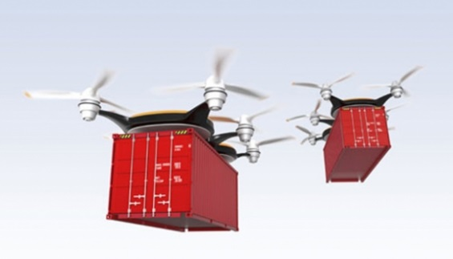



24GHz Radar Technology for
Broad Market Emerging Contactless Sensors
Emerging Applications
“Radar Sensor for the Emerging Masses”
ATS BU
(Autonomous Transportation & Safety)
Feb 2018
©2018 Analog Devices, Inc. All rights reserved.

Slide 2
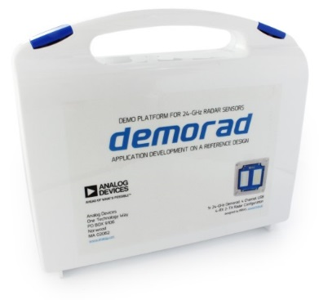
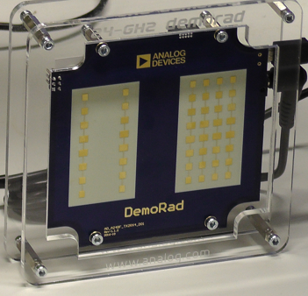
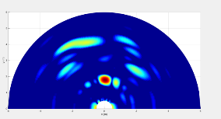
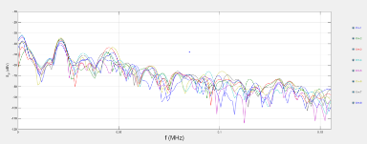
Agenda – introduction and evaluation of 24 GHz RADAR
Introduction to RADAR
Introduction to 24 GHz RADAR and applications
24 GHz RADAR chipset
24 GHz RADAR full system evaluation platform (DemoRAD)
Broad market RADAR use cases
24 GHz chipset product details
AFE/ADC product details
BF DSP Product details
Play introduction video

Slide 3
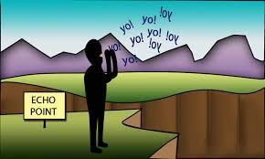
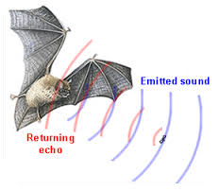
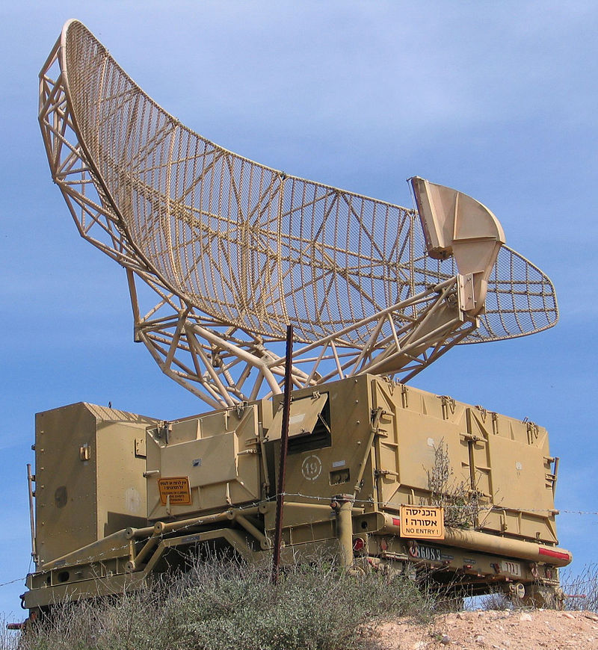
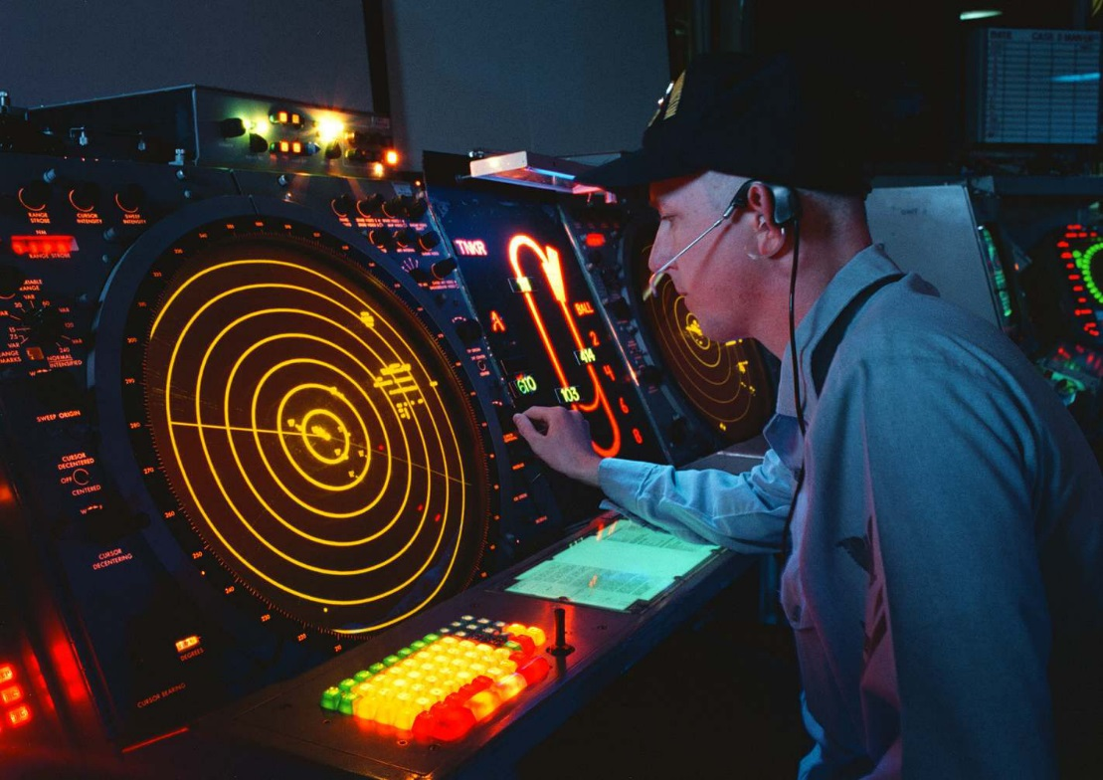
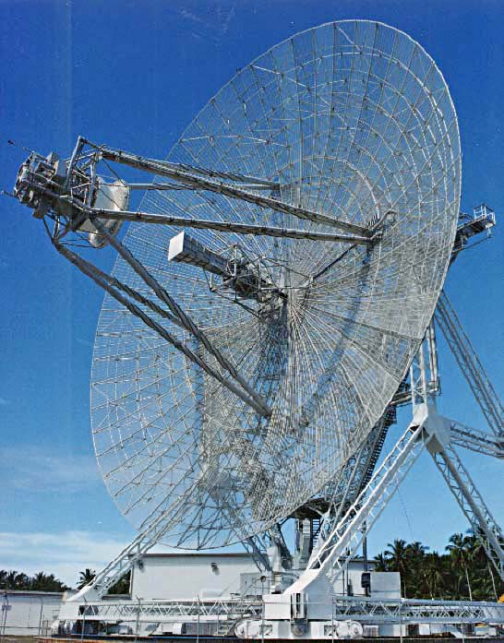
This is Traditional “Radar” “RAdio Detection And Ranging”
Very Old Principle: Sound Waves and Echo used to Judge distant (TOF) of large objects .. Cliffs or walls
RADAR based on same principle using RF:
RF signal and Echo/Reflections used to estimate distant / range of objects .. And with multiple Receivers .. Allows more reflections to be received returning at different angles thereby giving object angle information and therefore position with Doppler freq used to determine movement to/from TX
©2018 Analog Devices, Inc. All rights reserved.

Slide 4
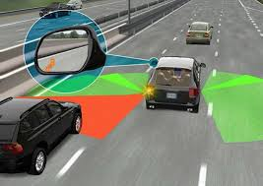
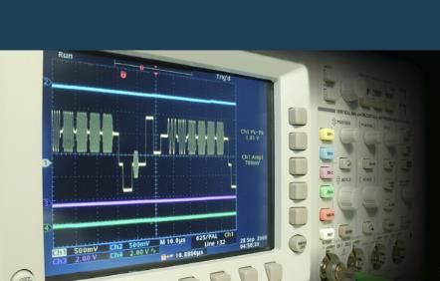
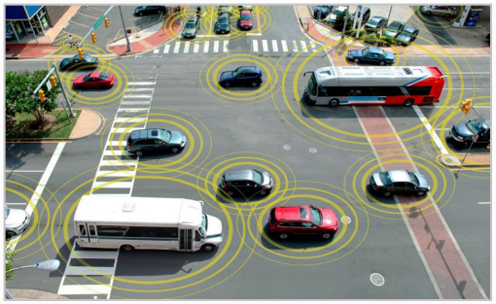
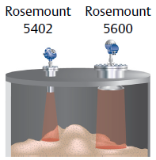
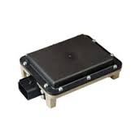

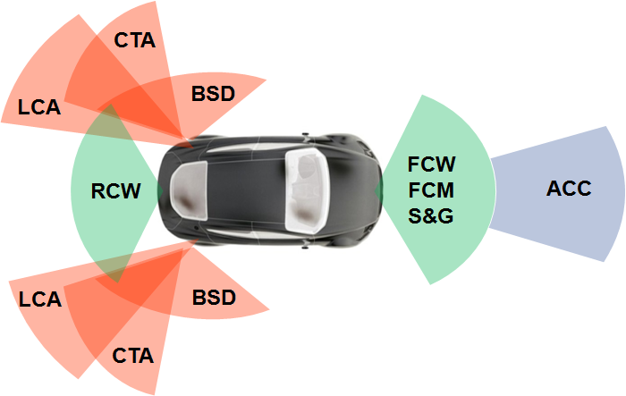
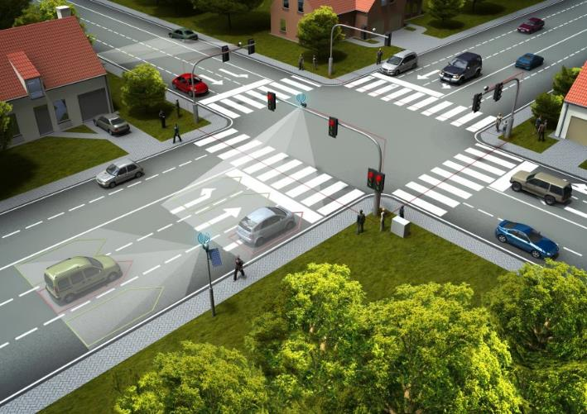
This is new RADAR - Localized Sensing
Automotive Radar
Industrial Tank Level Radar
ADAS Radar sensor
Intelligent Traffic Light Monitor Radar
©2018 Analog Devices, Inc. All rights reserved.

Slide 5

24 GHz Industrial Broad Market Radar Three Major Industrial Application Segments
Smarter World
Many new opportunities emerging served by 24 GHz RF Radar Products that exist Today
Analog Devices offers many product solutions for 24 GHz radar sensors for emerging sensing applications
Multi-Channel Radar for Object Detection & Tracking
Smart Cities (Intelligent Traffic Monitoring & Control - Traffic flow & Infrastructure mgmt.)
Surveillance & Security Monitoring
Collision warning & avoidance – Boats/Train/UAV’s /Grounded Aircraft
Radar for Precision Level Detection
Industrial Proximity Measurement - Robotics
UAV’s Altimeters
Industrial Tank Level sensors
Radar for Vital signs Monitor & Detection
Vehicle Operators, Pilots, First Responders
Elder care (aging-in-place)
Room Occupancy (smart buildings)
© Analog Devices, Inc. 2018, all rights reserved.

Slide 6
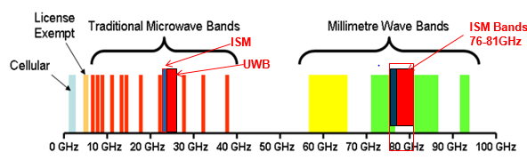
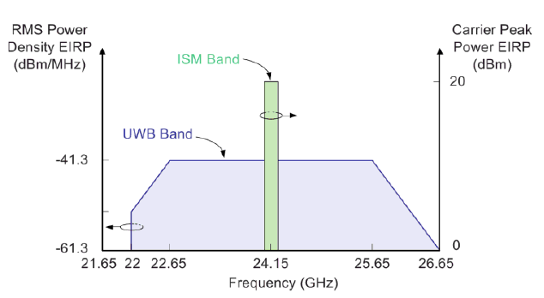
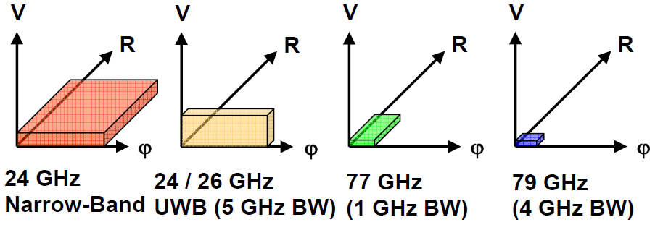
Radar Frequencies & Sensor Performance comparisons
Non-
©2018 Analog Devices, Inc. All rights reserved.

Slide 7
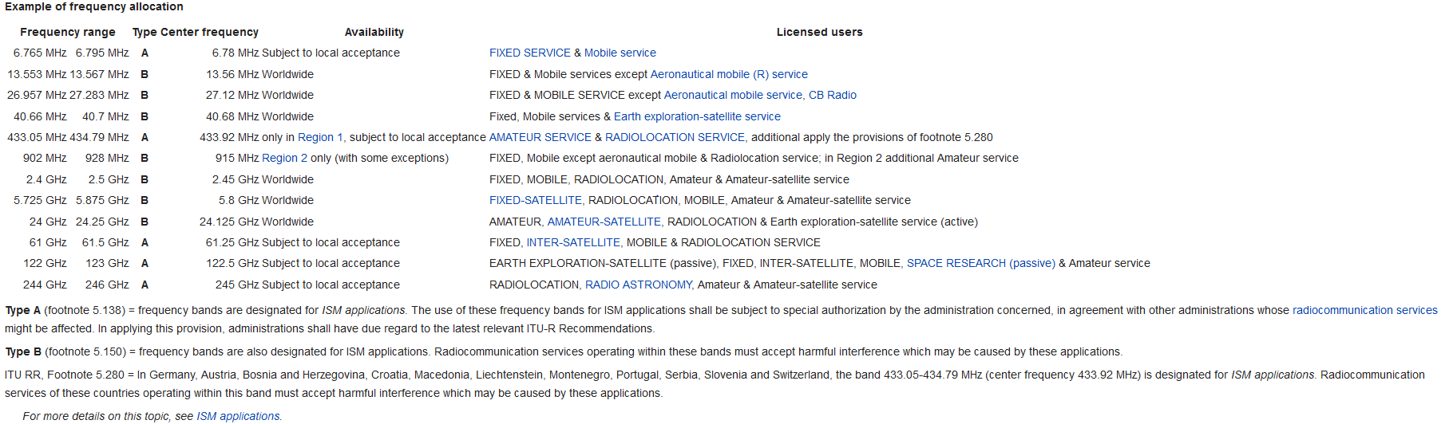
ITU World-Wide assigned ISM Band Frequencies 6 MHz to 250 GHz unlicensed spectrum:
mmw freq ISM bands
24 GHz is a WW available unlicensed ISM band
77 GHz/79 GHz is not an ISM band
Restricted to Auto ADAS, Traffic Monitoring & Tank Level sensing applications only

Slide 8
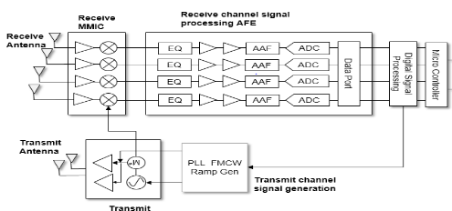










Analog Devices – Broad Market Radar group offers: 24 GHz Radar Full Signal Chain solution – Applicable to many emerging Industrial Sensing applications
RF, Microwave Group
RF Antenna Element
Computer and Software
Mixed Signal Processing
Interface and Software Support
RF Sub section
©2018 Analog Devices, Inc. All rights reserved.

Slide 9
24 GHz RADAR chipset
and
24 GHz RADAR demo platform (DemoRAD)

Slide 10
24 GHz ISM Multi-channel Radar Signal Chain Solution Complete 24 GHz RADAR Solution - RF to Bits
ADF5904
24 GHz, 4-channel Rx Downconverter
SPI programmable
Integrated temperature sensor
LO power detector
Rx Chip (1)
ADF5904
AD8283
Analog baseband (AFE)
High speed ramps
12 MHz input BW
12-bit, 80 MSPS (all channels)
ADAR7251
Analog baseband (AFE)
Low speed ramps
1.2 MHz input BW
16-bit, 2.4 MSPS (per channel)
AD8285 - 4 Ch (1)
ADAR7251 - 4 Ch (1)
Receive channel signal processing AFE
Receive Antenna
EQ
AAF
ADC
Data Port
DSP
MCU
EQ
AAF
ADC
Audio alert
EQ
AAF
ADC
Digital
EQ
AAF
ADC
ADSP-BF70 or
ADSP-2147x (DSP)
Transmit Antenna
PLL FMCW Ramp Gen
Transmit channel signal generation
Digital signal processing solution included
M*
PLL (1)
ADF4159/
ADF4158
ADF4159
0.5 – 13 GHz Frac-N Synthesizer
25-bit divider modulus
110 MHz PFD
Architecture Benefits and ADI Value
on next slide
Tx Chip (1)
ADF5901
ADF5901
24 GHz, 2-channel transmitter
8 dBm power amplifier
-85 dBc/Hz @ 100 kHz VCO
-105 dBc/Hz @ 1 MHz VCO
Best in class phase noise and high speed FMCW ramping for increased resolution
© Analog Devices, Inc. 2018, all rights reserved.

Slide 11
24 GHz ISM Multi-channel Radar Signal Chain Solution Complete 24 GHz RADAR Solution - RF to Bits
Architecture Benefits
Multi channel architecture allows: beam forming for better field of view and angle resolution
Provides spatial flexibility
Simplifies design architecture with integration
ISM band allows worldwide application without restrictions
ADI Value
Full signal chain solution
Analog front end
Mixed signal solution
Digital baseband
Higher integration simplifies design and reduces time to market
Wider field of view with multiple channels
Separate Tx and Rx modules to provide flexibility in spatial design
Better noise and linearity resulting in greater effective range and accuracy
© Analog Devices, Inc. 2018, all rights reserved.

Slide 12
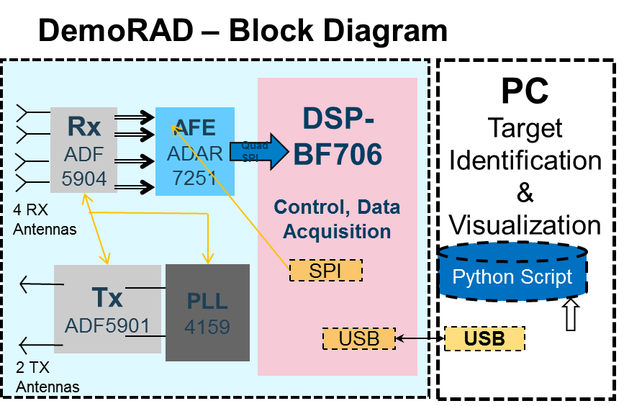
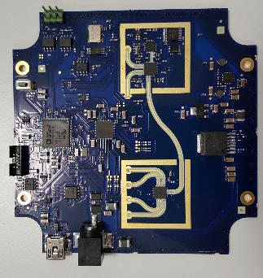
Analog Devices 24 GHz Radar Sensor Platform “DemoRAD” Application Development on a Reference Design
4RX2TX (MIMO) Radar + ADI-BF-DSP digital baseband + plus basic Radar software & GUI
Radar macros in DSP library
ADSP-BF706
ADAR7251 AFE
ADF4159 PLL
ADF5904 RX
ADF5901 TX
Single PC Board
(USB Interface to PC)
Full ADI - Signal Chain - RF to Bits
Plugs into Laptop using USB
Running Object Detection Mode
©2018 Analog Devices, Inc. All rights reserved.

Slide 13
24 GHz Radar Sensor Eval Platforms – Solution Application Development on a Reference Design
These solutions provide excellent aids to customers to achieve the following:-
Low cost introduction to 24 GHz RF HW/SW sensor eval kit
No need for expensive RF test & measurement equipment
Quick and easy setup in minute to PC
Understanding of RADAR HW and basic SW
RF HW expertise and support
Speeds up customer RADAR system evaluation
Move quickly to reference design using “DemoRAD” platform
Access to system partners or internal system experts
Develop product with faster time to market
DemoRAD – Block Diagram
DSP-
BF706
Control, Data Acquisition
PC
Target Identification & Visualization
Rx
ADF5904
AFE
ADAR7251
Quad SPI
4 RX Antennas
Python Script
Tx
ADF5901
PLL
4159
SPI
USB
USB
2 TX Antennas
©2018 Analog Devices, Inc. All rights reserved.

Slide 14
Demorad – Radar modes of operation Basic Radar Algorithms - Screen Shots
FMCW Mode
Raw Data Capture
Radar sys data Range Data over time
Range Doppler Mode
Digital Beam Forming Mode
Range and velocity of target
Distance and angle of target
©2018 Analog Devices, Inc. All rights reserved.

Slide 15
24 GHz RADAR Broad Market Applications Examples
©2018 Analog Devices, Inc. All rights reserved.

Slide 16
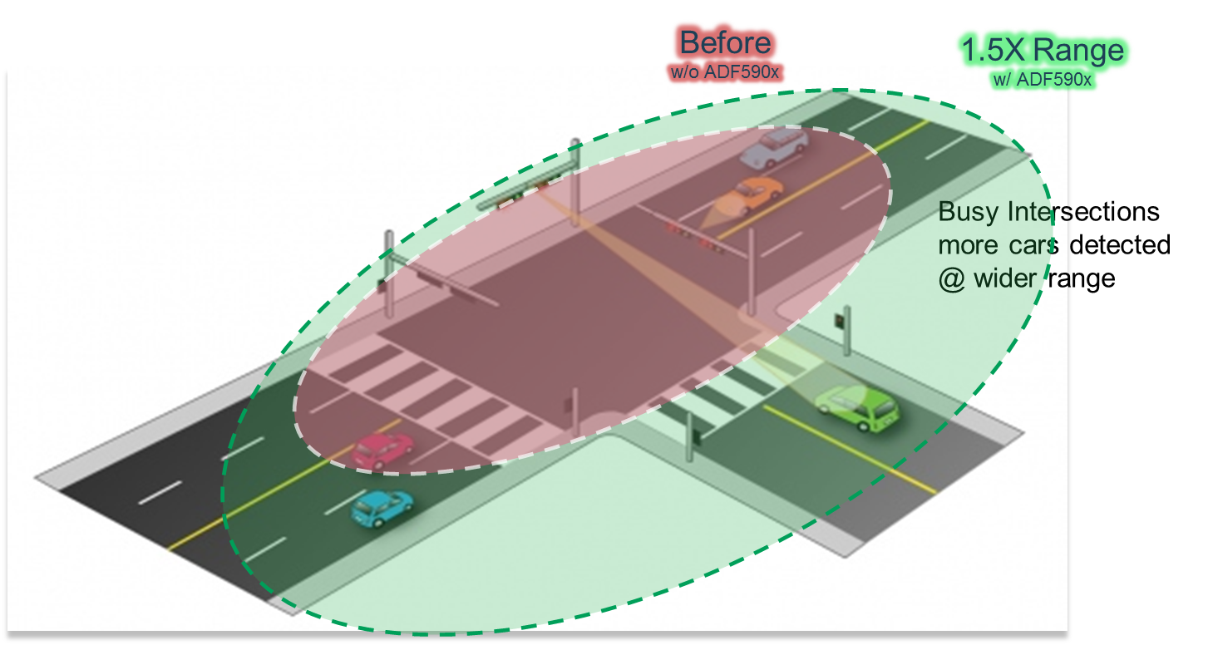
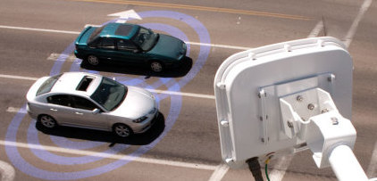
Use case: Intelligent Traffic Light Monitors Automating traffic light signals management to optimize the flow of traffic
See brochure: “Enabling Smart Traffic
With Advanced Traffic Control Systems”
Play video: “DemoRad_TrafficMonitoring2.avi”
Intelligent Traffic Light Radar Sensor
Technical Solution
24 GHz ISM Multi channel FMCW Radar
ADF5901 (2 Transmit Channels) + ADF5904 (4 Receive Channels)
ADF4158/9 (FMCW PLLs) with FMCW ramp generator
ADAR7251/AD8285 4-channel low/high speed 12/14bit-ADC Signal conditioning
ADSP-BF70X Digital signal processor
Multi channel system for digital beam forming:
Wider field of view
Best angular resolution
Multi vehicle and person detection
Higher receiver system SNR than current available solutions
3 dB better receiver noise figure
Improved high performance transmitter phase noise, output power and high speed FMCW ramping
3D Tracking sensor
Key Benefits
More than ×2 times improvement in sensitivity
More than ×1.5 times better detection range
Much lower power consumption for small form outdoor use, with alternate and renewable power supply options
© Analog Devices, Inc. 2018, all rights reserved.

Slide 17


Use case: Surveillance & Security Monitoring Motion detection and tracking of objects to optimize Surveillance & Security Systems
Technical Solution
24 GHz ISM Multi channel FMCW Radar
ADF5901 (2 Transmit Channels) + ADF5904 (4 Receive Channels)
ADF4158/9 (FMCW PLLs) with FMCW ramp generator
ADAR7251/AD8285 4-channel low/high speed 12/14bit-ADC Signal conditioning
ADSP-BF70X Digital signal processor
Multi channel system for digital beam forming:
Wider field of view
Best angular resolution
Multi object or person detection & tracking
Higher receiver system SNR than current available solutions
3 dB better receiver noise figure
Improved high performance transmitter phase noise, output power and high speed FMCW ramping
Motion & Tracking Sensor
Key Benefits
More than ×2 times improvement in sensitivity
More than ×1.5 times better detection range
Much lower power consumption for small form outdoor use, with alternate and renewable power supply options
© Analog Devices, Inc. 2018, all rights reserved.

Slide 18
Use case: Surveillance & Security Monitoring Motion detection and tracking of objects to optimize Surveillance & Security Systems
Technical Solution
24 GHz ISM Multi channel FMCW Radar
ADF5901 (2 Transmit Channels) + ADF5904 (4 Receive Channels)
ADF4158/9 (FMCW PLLs) with FMCW ramp generator
ADAR7251/AD8285 4-channel low/high speed 12/14bit-ADC Signal conditioning
ADSP-BF70X Digital signal processor
Multi channel system for digital beam forming:
Wider field of view
Best angular resolution
Multi object or person detection & tracking
Higher receiver system SNR than current available solutions
3dB better receiver noise figure
Improved high performance transmitter phase noise, output power and high speed FMCW ramping
Motion & Tracking Sensor : Radar Plus Camera
Key Benefits
More than ×2 times improvement in sensitivity
More than ×1.5 times better detection range
Much lower power consumption for small form outdoor use, with alternate and renewable power supply options
© Analog Devices, Inc. 2018, all rights reserved.

Slide 19

Use case: Unmanned Aerial Vehicle Automatic Collision Avoidance Systems Enabling safer and more autonomous aerial navigation
Technical Solution
Full RADAR signal chain solution including the DSP and baseband solution
24 GHz ISM Multi channel FMCW Radar
ADF5901 (2 Transmit Channels) + ADF5904 (4 Receive Channels)
ADF4158/9 (FMCW PLL) with FMCW ramp generation
ADAR7251/AD8285 4-channel low/high speed 12/14bit-ADC Signal conditioning
ADSP-BF70X Digital signal processor
Multi channel system for digital beam forming:
Wider field of view
Best angular resolution
Multi object detection and tracking
Independent low noise transmit and receive functions for spatial flexibility
integrated RF power detectors to enable self test diagnostics
Integrated temperature sensor to reduce components and temperature calibration
Key Benefits
×2 times improvement in sensitivity for object detection
×1.5 times better detection range, to increase speed of autofocus UAV navigation
Lower power consumption reduces UAV payload and battery needs
© Analog Devices, Inc. 2018, all rights reserved.

Slide 20
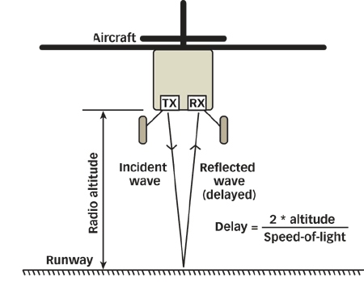
Use case: Radio Altimeters on Unmanned Aerial Vehicles Automating detection of ground or crops tops for optimum low flight operation during inspections or crop spraying
Technical Solution
24 GHz ISM Multi channel FMCW Radar
ADF5901 (2 Transmit Channels) + ADF5904 (4 Receive Channels)
ADF4158/9 (FMCW PLL) with FMCW ramp generation
ADAR7251/AD8285 4-channel low/high speed 12/14bit-ADC Signal conditioning
ADSP-BF70X Digital signal processor
Higher receiver system SNR than present available solutions
3 dB better noise figure
Improved high performance phase noise, output power and high speed ramping
Independent transmit and receive functions for spatial flexibility
integrated RF power detectors to enable self test diagnostics
Integrated temperature sensor to reduce components and temperature calibration
Key Benefits
24 GHz over traditional 4.3 GHz improves range, accuracy and reduces size
4 times the number of channels increases field of view and angle resolution
Separate Tx and Rx allows for for spatial distribution of antenna elements
Fewer components leading to simpler design, and quicker time to market
Easier development with complete signal chain solution from single supplier
© Analog Devices, Inc. 2018, all rights reserved.

Slide 21
Use case: Automotive ACAS Radar Safety Auto safety features – collision avoidance - blind spot detection, lane change assist, cross traffic alert
Technical Solution
24 GHz ISM Multi channel FMCW Radar
ADF5901 (2 Transmit Channels) + ADF5904 (4 Receive Channels)
ADF4158/9 (FMCW PLLs) with FMCW ramp generator
ADAR7251/AD8285 4-channel low/high speed 12/14bit-ADC Signal conditioning
ADSP-BF70X Digital signal processor
Multi channel system for digital beam forming:
Wider field of view
Best angular resolution
Multi vehicle detection
Higher receiver system SNR than current available solutions
3 dB better receiver noise figure
Improved high performance transmitter phase noise, output power and high speed FMCW ramping
ADAS Radar sensor
Key Benefits
More than ×2 times improvement in sensitivity
More than ×1.5 times better detection range
Much lower power consumption for small form factor
© Analog Devices, Inc. 2018, all rights reserved.

Slide 22

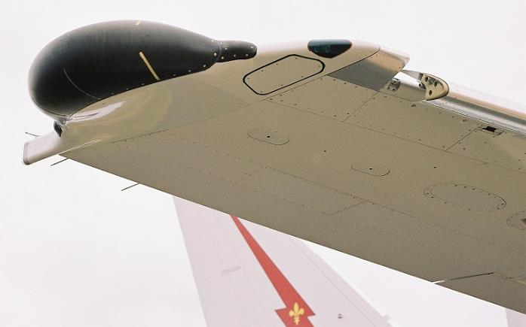
Use case: Aviation Wingtip Radar for Collision Avoidance while Grounded/During Taxiing
Challenge
Aircraft wingtips are subjected to taxi incidents that can be extremely expensive especially with the addition of Winglets
Many accidents happen when aircraft are being moved by a tug
Wing walkers are not specifically trained in taxi and pushback procedures (they are usually baggage handlers)
Technical Solution
Repurpose automotive radar to provide detection for buildings, other aircraft wings and on tarmac vehicles
Flexibility with antennas and small mounting size allows from integration into lighting package
Key Benefits
Proven existing technology
Low costs and flexible design
Lower power consumption allows for use when engines are off
©2018 Analog Devices, Inc. All rights reserved.
Notes:
Colission avoidance.

Slide 23


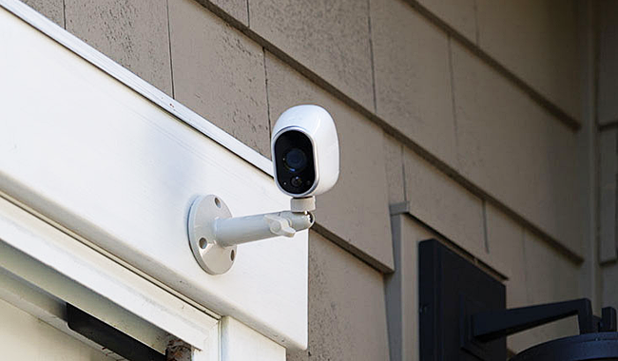
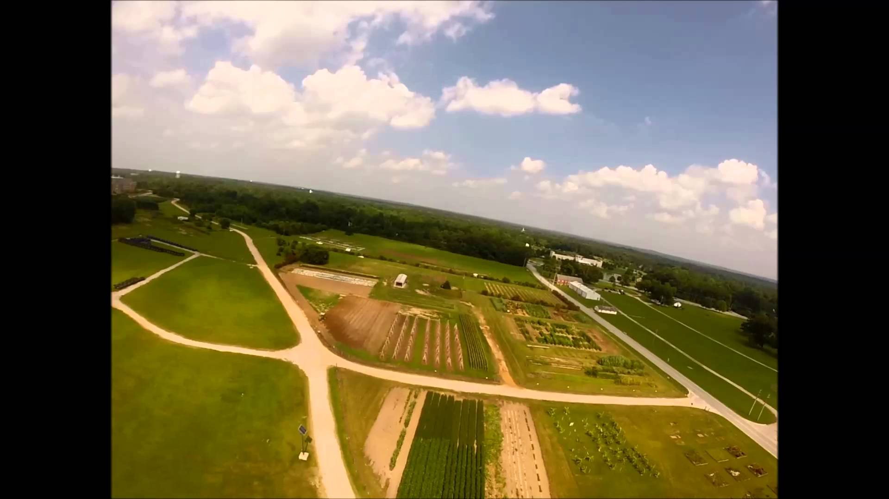
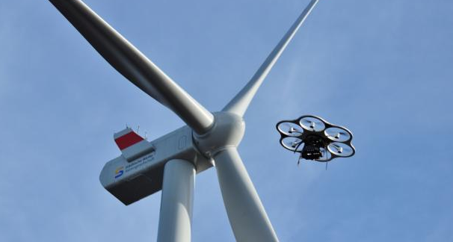
Analog Devices 24 GHz FMCW Radar Market Summary of Broad Market Applications
Intelligent Traffic Light Monitors
Industrial Tank Level Sensor
Automotive Radar
Technical Solution
Motion - Surveillance & Security
Radio Altimeter
Collision Avoidance System
© Analog Devices, Inc. 2018, all rights reserved.

Slide 24
Radar Technology
24 GHz Radar System Solution Details
©2018 Analog Devices, Inc. All rights reserved.

Slide 25
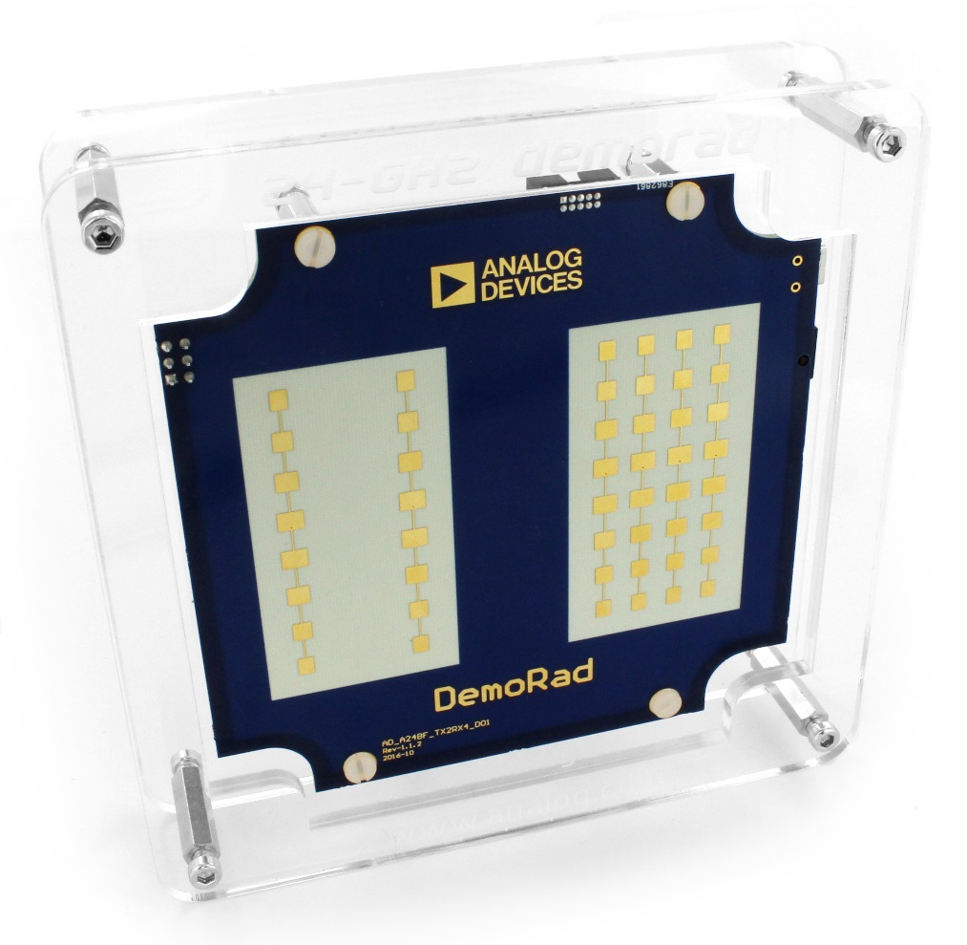
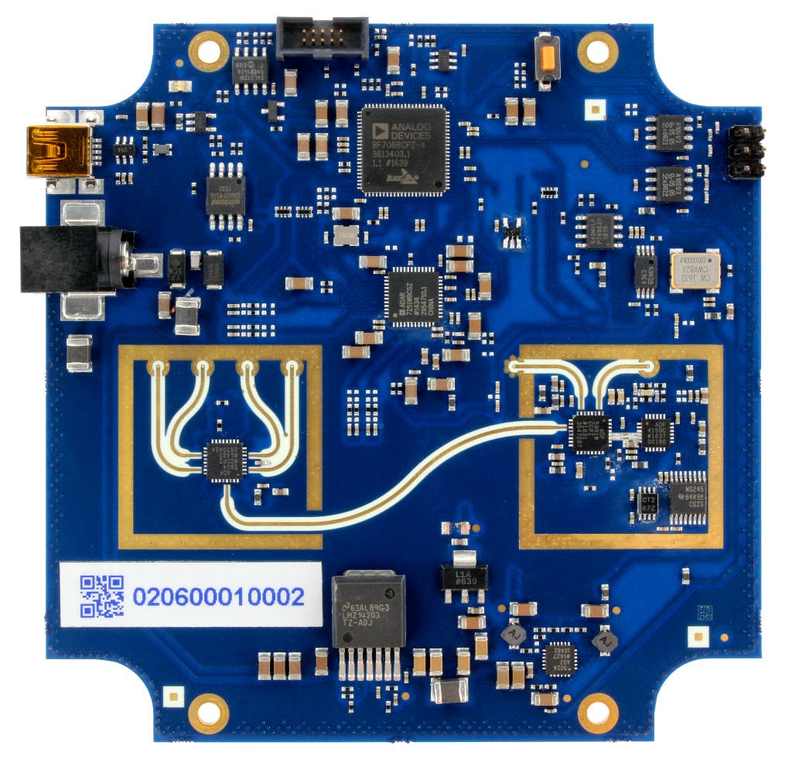
Analog Devices 24 GHz Radar Sensor Platform “DEMORAD” Application Development on a Reference Design - Available on SAP for Purchase
4RX2TX (MIMO) Radar + ADI-BF-DSP digital baseband + plus basic Radar software & GUI
Radar macros in DSP library
ADSP-BF706
ADAR7251 AFE
ADF4159 PLL
Single Board
ADF5904 RX
ADF5901 TX
(USB Interface to PC)
©2018 Analog Devices, Inc. All rights reserved.

Slide 26
Analog Devices 24 GHz Radar Sensor Platform “DemoRAD” Application Development on a Reference Design
DemoRAD is a standalone radar system with a 24 GHz MIMO FMCW frontend featuring two transmit (TX), four receive (RX) channels, ADC, and a Blackfin DSP from Analog Devices. The system is mainly designed for range-Doppler and MIMO radar applications and the DSP enables real-time signal processing capabilities. The antenna arrangement is chosen to support a uniform virtual array with a spacing of half the wavelength. When using both TX antennas 7 virtual elements can be generated with two virtual element overlapping in order to implement motion compensation algorithms. The main features of the 24 GHz radar system include
24 GHz ISM band operation
Sampling rate up to 1.2 MSPS per IF channel
Ramp Synchronous sampling
Freely programmable FMCW timing
MIMO processing with arbitrary antenna activation
Real-time signal processing on the Blackfin DSP
USB 2.0 interface for communication.
©2018 Analog Devices, Inc. All rights reserved.

Slide 27
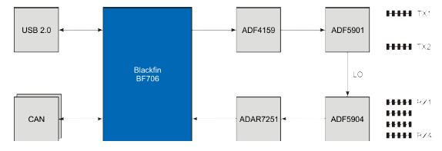
“DemoRAD” Block Diagram System Eval & solution
A Blackfin BF706 DSP is used to control the RF frontend and to process the measured radar signals of the receive channels. An ADF5901 dual-channel transmitter in conjunction with the frequency-synthesizer ADF4159 is used to generate the FMCW transmit signal. The two TX antennas (TX1, TX2) are fed from the ADF5901 transmitter whereas the receive path of the frontend is realized with a ADF5904 quad-channel receiver. An ADAR7251 analog frontend is used to amplify and sample the measured IF signals of the receiver. Thereafter, the signals are processed in the DSP and the results can be accessed with a USB 2.0 interface. The entire board including the power supply is designed on a single PCB with a total size of 100 mm × 100 mm.
©2018 Analog Devices, Inc. All rights reserved.

Slide 28
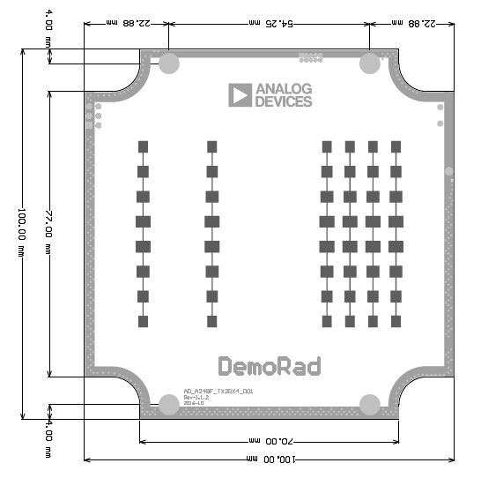
PCB Mechanical Data
©2018 Analog Devices, Inc. All rights reserved.

Slide 29
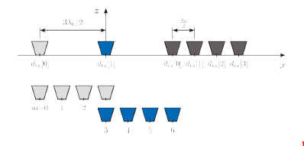
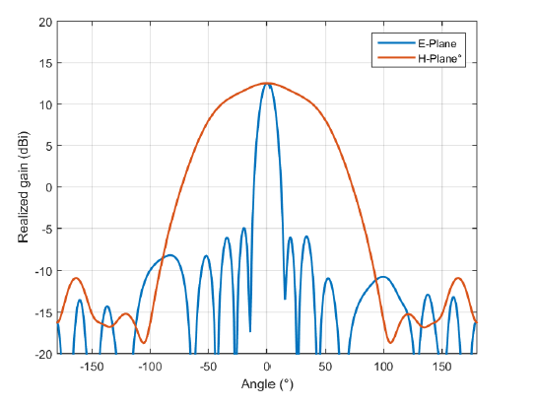
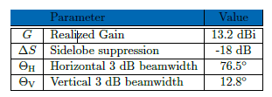
Antenna Details
The serial fed patch antennas feature eight elements with an amplitude taper and are fed from the backside of the PCB. The antennas are fabricated on a Rogers 4350 substrate.
Antenna arrangement with virtual antenna positions.
©2018 Analog Devices, Inc. All rights reserved.

Slide 30
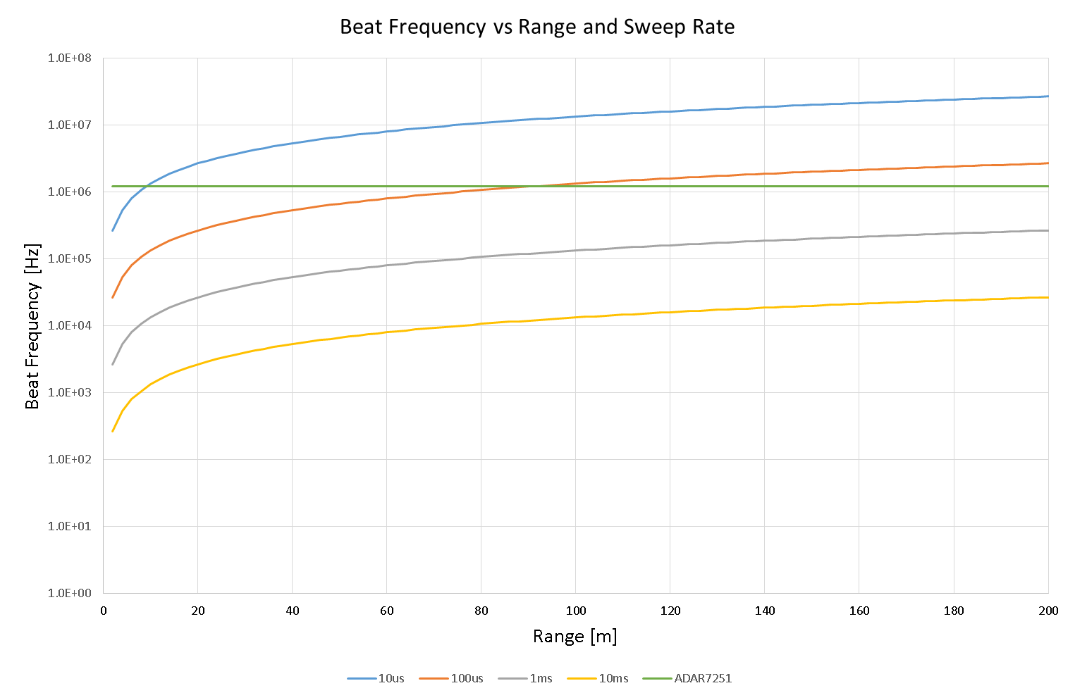
RadarBook vs DemoRAD comparison Ramp Sweep Rate and Range vs Beat Frequency
RadarBook (AD8283)
HSR
Low – medium speed FMCW ramps
DemoRad (ADAR7251)
©2018 Analog Devices, Inc. All rights reserved.

Slide 31
DemoRAD – Basic Radar Algorithms FMCW Mode - Screen Shots
Raw Data Capture
Radar sys data Range Data over time
©2018 Analog Devices, Inc. All rights reserved.

Slide 32
DemoRAD – Basic Radar Algorithms Range Doppler Mode
Range and velocity of target
©2018 Analog Devices, Inc. All rights reserved.

Slide 33
DemoRAD – Basic Radar Algorithms Digital Beam Forming Mode – angle position measurement
Distance and angle of target
©2018 Analog Devices, Inc. All rights reserved.

Slide 34
Analog Devices 24GHz Sensor Solution Roadmap
Discrete solutions
(5, 10, 24, 60, 78 GHz)
Multichannel integrated 24 GHz ISM radar
Single channel fully integrated 24 GHz wideband radar
Multiple design options, high flexibility
One stop shop for all your signal chain needs
Committed to investing for your future success
©2018 Analog Devices, Inc. All rights reserved.

Slide 35
Radar Technology
24 GHz Radar Chipset Product Details
©2018 Analog Devices, Inc. All rights reserved.

Slide 36
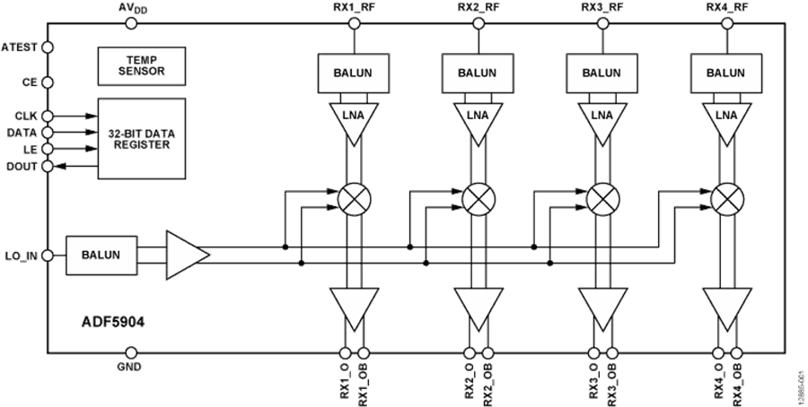
ADF5904: 4 Channel Receiver Rx MMIC for 24GHz FMCW Radar Applications
Key Specifications
Rx channel gain: 22 dB
Integrated baluns for single-ended receiver (Rx) inputs and local oscillator (LO) input
Noise figure of 10 dB
P1dB: −10 dBm
LO input range: −8 dBm to +5 dBm
Rx to IF isolation: 30 dB
RF signal bandwidth: 250 MHz
Rx output impedance: 900 Ω differential
LO input buffer: 24 GHz
RF and LO S11 at 50 Ω: −5 dB
Temperature sensor with analog output: ±5°
Electrostatic discharge (ESD) performance
Human body model (HBM): 2000 V
Charged device model (CDM): 500 V
Qualified for automotive applications
-40 ºC to 105 °C operation
Key Benefits
Highest performance and integration level for 24 GHz multichannel receiver in the industry
Lower total cost of ownership for Rx:
Highly integrated design eliminates the need for discrete
Small size sensors using 4 channels in single chip
Lower power consumption
Ease of adoption and use
Increased reliability using built in test capability
©2018 Analog Devices, Inc. All rights reserved.

Slide 37
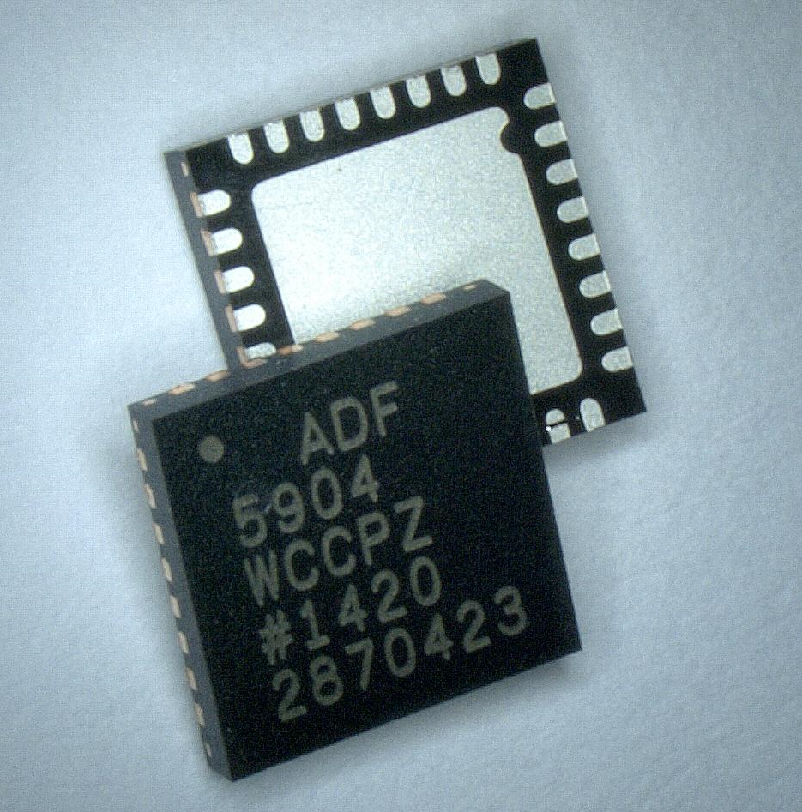
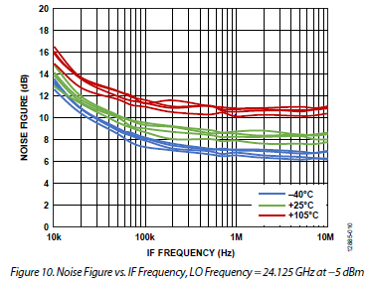
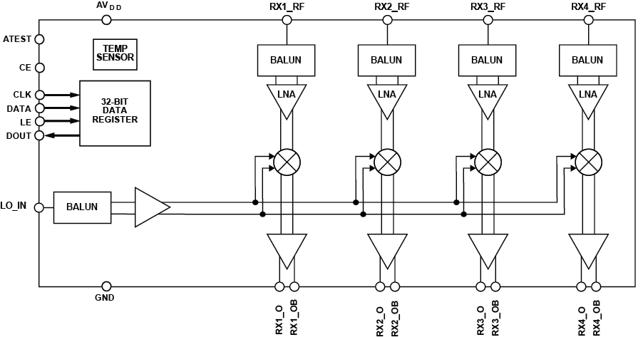
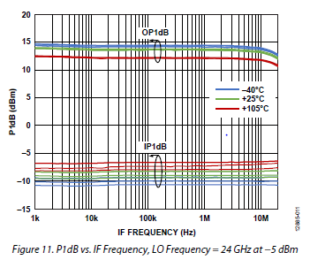
ADF5904: 4 Ch. 24 GHz Receiver Rx MMIC for 24 GHz FMCW Radar Applications
RX Noise Figure vs. RF Freq
Block Diagram
Key Features
Single-ended Rx inputs: S11 < -12 dB
20 dB Rx Gain (Fixed)
NF ≤ 10 dB, P1dB = -10 dBm, IIP3 = 0 dBm
24 GHz LO input range -20 dBm to 0 dBm
RX to RX isolation 30 dB
250 MHz Signal Bandwidth
±5° C Temp Sensor, SPI & single 3.3 V supply
Auto Temperature Range (-40 °C to 105 °C)
Integrated Test monitors
Small 5 mm × 5 mm 32-lead LFCSP package
AECQ100 Automotive Qualified
All 4 Ch - Power Consumption ~500 mW
30 dB Rx to Rx isolation
The industry’s best combination of low-noise, high linearity and low-power consumption.
“Best combination of 24 GHz performance and integration on the market”
“Industrial Sensor Customer Testimonial”
High level of µwave integration
enables simpler PCB system design
ease of use
faster time to market.
RX P1dB
Key Benefit
High Performance Low Power 24 GHz Multi-Channel Receiver
©2018 Analog Devices, Inc. All rights reserved.
Notes:
Slide NOTE:
Help the field to keep the messages clean and clear to customers, and add speaker notes for their use. Include at least major bullet points to be used as discussion points with customers during a presentation.

Slide 38
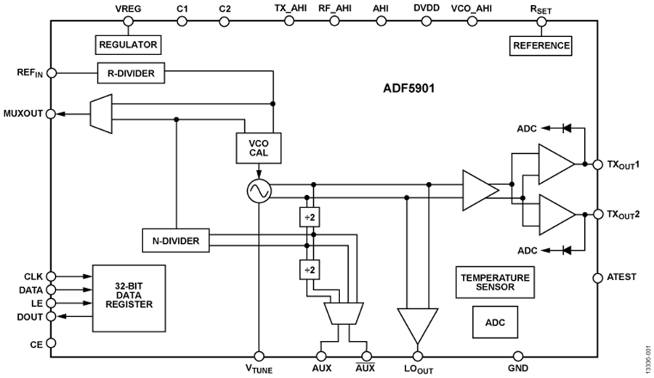

ADF5901: 2 Channel Transmitter and VCO Tx MMIC for 24 GHz FMCW Radar applications
Key Specifications
24 GHz VCO with 2 channel power amplifier output
24 GHz to 24.25 GHz voltage controlled oscillator (VCO)
2-channel 24 GHz power amplifier with 8 dBm output
Single-ended outputs
2-channel muxed outputs with mute function
Programmable output power of -5 dB to +8 dB in 1 dB steps
N divider output (frequency discriminator)
24 GHz local oscillator (LO) output buffer
250 MHz signal bandwidth
VCO Phase noise:
-85 dBc/Hz @ 100 kHz offset
-105 dBc/Hz @ 1 MHz offset
Power control detector
Auxiliary 8-bit ADC
±5°C integrated temperature sensor
Programmable SPI interface
Single supply operation at -3.3 V
170 mA current @ 3.3 V: 560 mW @ 100% duty cycle
Operating temperature range of -40 °C to +105 °C
32-lead, 5 mm × 5 mm LFCSP
Key Benefits
Highest performance integration level for 24 GHz multi-ch transmitter in the industry
Low Phase Noise VCO with on-chip auto cal
Lower total cost of ownership for Tx:
Highly integrated design eliminates the need for discrete
Small size using 2 channels in single chip
Lower power consumption
Ease of adoption and use
Increased reliability using built in test capability
© Analog Devices, Inc. 2018, all rights reserved.

Slide 39
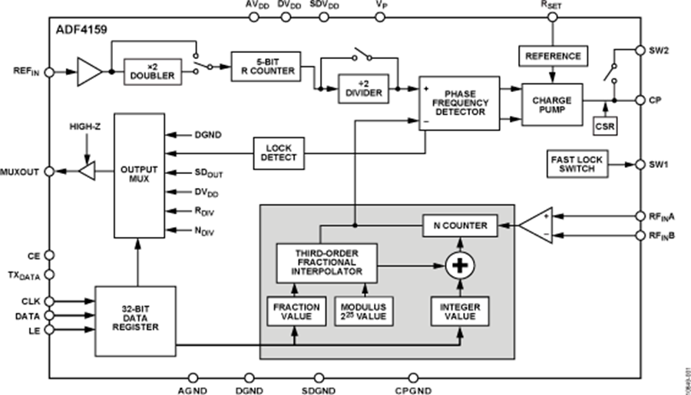
ADF4159: Direct Modulation/ Waveform Generating 13 GHz Fractional-N Frequency Synthesizer PLL with ramp function for 24 GHz FMCW Radar applications
Key Specifications
500 MHz – 13 GHz range
25-bit divider modulus
Sub-1 Hz frequency resolution
110 MHz PFD maximum frequency
Normalized phase noise floor of -224 dBc/Hz
Programmable phase control
2.7 V to 3.45 V analog power supply
1.8 V digital power supply
Programmable charge pump currents
3-wire programmable serial interface
Digital lock detect
FSK and PSK modulation capabilities
Supports fast ramps
Ramp delay, frequency reed back and interrupt functions
Generates highly linear saw tooth and triangular waveforms
Cycle slip reduction for fast lock times
ESD performance: 3000 V HBM, 1000 V CDM
Qualified for automotive applications
24-LFCSP (4mm × 4mm) package
© Analog Devices, Inc. 2018, all rights reserved.

Slide 40
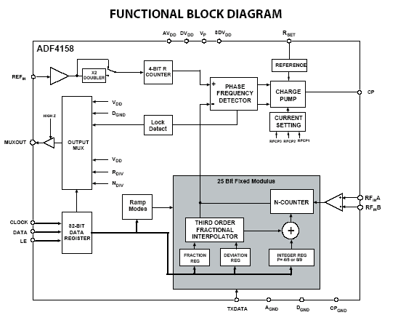
ADF4158: Direct Modulation/Waveform Generating 6 GHz Fractional-N Frequency Synthesizer for Slow-Sweep Ramps
KEY FEATURES:
500 MHz – 6 GHz Range
25-bit divider modulus
32 MHz PFD maximum frequency
Supports fast Ramps
Normalized PN Floor = -207 dBc/Hz
FSK Modulation up to 32 MHz PFD
Sub-1Hz frequency resolution
FSK and PSK modulation capability
Generates highly linear saw tooth and triangular waveforms
Cycle slip reduction for fast lock times
24-LFCSP (4mm × 4mm)
Key Benefit
6 GHz Frac-N PLL with FMCW Ramping Waveform Generator
©2018 Analog Devices, Inc. All rights reserved.

Slide 41
FMCW - Frequency Modulated Continuous Wave Radar Principle (simplified, static condition)
FMCW Radar
Distance: D
f_{t}
f_{b}=f_{t}-f_{r}
f_{r}
f_{t}: Transmit Frequency
f_{r}: Receive Frequency
D: Distance
t_{d}: Time of flight for D f_{b}: Beat Frequency
f_{DEV}: Sweep Frequency
t_{s}: Sweep Time c: Light Speed Constant
BW: Max AFE Bandwidth
(1) t_{d} = 2*D/c
t_{s}
f_{r}
24.25 GHz
f_{t}
(2) D = c*t_{s}*f_{b}/(f_{s}*2)
f_{DEV}
f_{b}
(3) BW = f_{DEV}*t_{dmax}/t_{s}
t
(4) BW = f_{DEV}*2*D_{max}/(c*t_{s})
24.05 GHz
t_{d}
©2018 Analog Devices, Inc. All rights reserved.

Slide 42
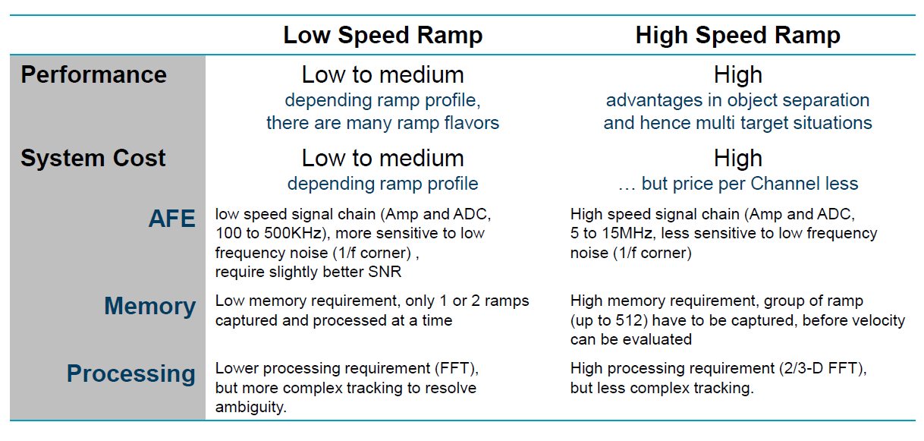
LSR vs HSR FMCW Radar
©2018 Analog Devices, Inc. All rights reserved.

Slide 43
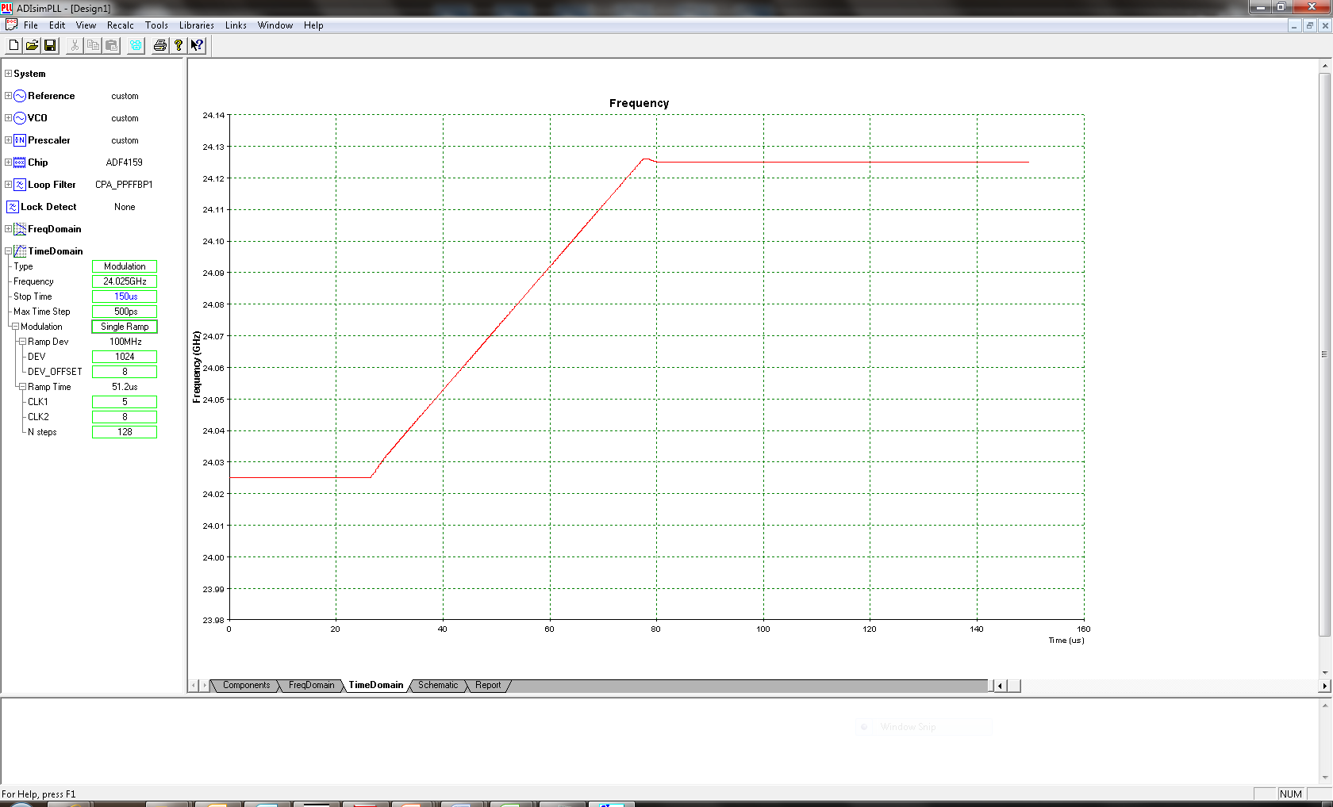
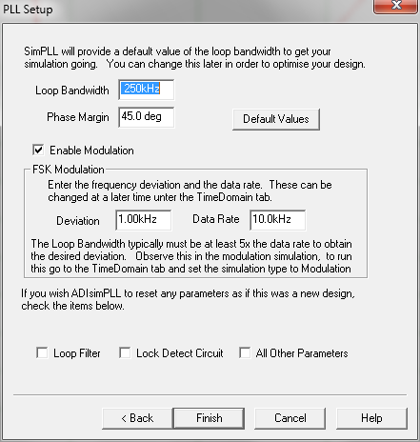



ADIsimPLL: Simulation Tool for FMCW PLL Ramp Support http://www.analog.com/ADIsimPLL

Slide 44
Radar Technology
Radar
AFE-ADC Product Details
©2018 Analog Devices, Inc. All rights reserved.

Slide 45
Analog Baseband (AFE-ADC) Solution LNA, AAF and ADC
Analog Baseband (AFE)
LNA+AAF+ADC
HSR High Speed Ramps
AD8283/84/85
12 MHz Input Bandwidth 80 MSPS (all channel) 12-bit, 67 dB SNR 3.5 nV/√Hz @ 1 MHz 34 dB PGA 3rd Elliptical AAF programmable
Pipeline Converter 180 nm Advanced CMOS
LSR High Speed Ramps
ADAR7251
1.2 MHz Input Bandwidth 2.4 MSPS per channel 16-bit, 94.5 dB SNR @ 1.2 MSPS 3.8 nV/√Hz @ 1 kHz 45 dB PGA Inherent AAF Programmable EQ Build-in-Selftest for FuSa
Continuous-Time Sigma-Delta 180 nm Advanced CMOS
RX ADC Options for High Speed Ramp or Low Speed Ramp Radar systems
©2018 Analog Devices, Inc. All rights reserved.

Slide 46

ADAR7251 – 4ch Low Speed Ramp AFE Continuous Time Sigma Delta
Key Specifications
Low noise: 2.4 nV/√Hz input referred voltage noise at maximum gain setting
Wide input signal bandwidth: 500 kHz at 1.2 MSPS sample rate, 16-bit resolution
Additional sample rates supported: 300 kSPS, 450 kSPS, 600 kSPS, 900 kSPS, and 1.8 MSPS
4 differential simultaneous sampling channels
No active antialiasing filter required
LNA and PGA with 45 dB gain range in 6 dB steps
Selectable equalizer
Flexible data port supports serial or parallel mode
Supports FSK mode for FMCW radar systems
On-chip 1.5 V reference
Internal oscillator/PLL input: 16 MHz to 54 MHz High speed serial data interface
©2018 Analog Devices, Inc. All rights reserved.

Slide 47
AD8285 Radar Receive Path AFE: 4-Channel LNA/PGA/AAF with ADC
Key Specifications
4-channel LNA, PGA, and AAF
1 direct to ADC channel
Programmable gain amplifier (PGA)
Includes low noise preamplifier (LNA)
Serial peripheral interface (SPI) programmable gain 16 dB to 34 dB in 6 dB steps
Antialiasing filter (AAF)
Programmable third order, low-pass elliptic filter (LPF) from 1.0 MHz to 12.0 MHz
Analog-to-digital converter (ADC)
12 bits of accuracy up to 72 MSPS
Signal-to-noise ratio (SNR): 68.5 dB
Spurious-free dynamic range (SFDR): 68 dB at gain = 16 dB
Low power: 185 mW per channel at 12 bits and 72 MSPS
Low noise: 3.5 nV/√Hz maximum of input referred voltage noise
©2018 Analog Devices, Inc. All rights reserved.

Slide 48

AD8283 - RADAR Receive Path AFE: 6-Channel LNA/PGA/AAF with ADC
Key Specifications
6-channels (LNA, PGA, and AAF) multiplexed to one ADC
Programmable gain amplifier (PGA)
Includes low noise preamplifier (LNA) <3nV/rtHz @ max gain
Programmable gain 16 dB to 36 dB in 6 dB steps via SPI interface
Antialiasing filter (AAF)
Programmable 3rd order, low-pass elliptic filter (LPF) from 1.0 MHz to 12.0 MHz
Precise ch-to-ch matching
Gain: +/-0.5dB (-40 to 105°C)
Phase: +/-2.5° (-40 to 105°C)
Analog-to-digital converter (ADC)
14 bits of accuracy up to 80 MSPS
Signal-to-noise ratio (SNR): 70 dB
Spurious-free dynamic range (SFDR): 75 dB
Parallel 3.3V CMOS Output
Low power: 150 mW per channel
72 Lead LFCSP
-40 °C to 125 °C
©2018 Analog Devices, Inc. All rights reserved.

Slide 49

ADA8282 Radar Receive Path AFE: 4-Channel LNA and PGA
Key Specifications
4 channels of low noise amplifiers (LNA) followed by programmable gain amplifiers (PGA)
Minimum −3 dB bandwidth of 5 MHz
Typical –3 dB bandwidth of 42.3 MHz
Typical slew rate of 28 V/µs
Differential input and output
Gain of 18 dB to 36 dB in 6 dB steps
Selectable low noise and low power modes
Input referred noise of 4.5 nV/√Hz at 18.3 mW per channel
Input referred noise of 3.6 nV/√Hz at 34.8 mW per channel
Input referred noise of 3.4 nV/√Hz at 54.8 mW per channel
Qualified for automotive applications
©2018 Analog Devices, Inc. All rights reserved.

Slide 50



ADSP-BF706 Blackfin DSP Low Power 400 MHz Blackfin+ Embedded Processor with 1 MByte L2 SRAM
Key Specifications
Blackfin+ core with up to 400 MHz performance
- Dual 16-bit or single 32-bit MAC support per cycle
- 16-bit complex MAC and many other instruction set enhancements
- Instruction set compatible with previous Blackfin products
On-Chip Memory
- 136 KB L1 SRAM with multi-parity-bit protection (64 KB instruction, 64 KB data, 8 KB scratchpad)
- 1 MByte on-chip L2 SRAM with ECC protection
- 512 KByte On-chip L2 ROM
Key Peripherals include
- USB2.0 HS OTG
- 2× CAN2.0B
- ePPI Video I/O
- 2× SPORTs (w/I2S)
- 2× Quad-SPI / 1 × Dual-SPI (w/ Host mode option)
- I²C
- 2× UART
- SD/SDIO/MMC (4-bit)
Security and one-time-programmable memory
- Crypto hardware accelerators for fast secure boot/IP protection memDMA encryption/decryption for fast run-time security
Low-cost packaging
- 88-Lead LFCSP (QFN) package (12 mm × 12mm), RoHS compliant
Low system power with < 100 mW at 400 MHz (< 0.25 mW/MHz) at 25°C T_{JUNCTION}
©2018 Analog Devices, Inc. All rights reserved.

Slide 51
Industrial & Automotive Radar Product Signal Chain Roadmap
 | ADF4118
 | ADF4193
 | ADF4169 13.5 GHz FMCW Ramping PLL
 | Released To Sales
6 GHz fast hopping PLL
13.5 GHz FMCW ultra-Fast Ramp PLL
 | ADF4158 6 GHz FMCW Ramping PLL
RF PLL + FMCW Ramp Generation
 | ADF4159 13 GHz FMCW Ramping PLL
Value Drivers:
High RF Integration Levels with
Low Noise High Linearity performance
Low Power Consumption simplifies design and reduces time to market
Better noise and linearity resulting in greater effective range and accuracy
Qualified to AECQ100
13 GHz FMCW Fast Ramp PLL
RX AFE ADCs
 | AD8283/AD8284 High speed Ramp AFE
6 Ch & 4 Ch 80MSPS ADC
 | ADAR7251 Low speed Ramp AFE
4 Ch 1.8MSPS ADC
 | ADA8282 High speed AMP AFE
4 Ch VGA-ADC Driver
Microwave TX RX MMICs
 | ADF5904 24 GHz ISM RX MMIC
4 Ch 24GHz ISM Band RX MMIC
 | ADF5901 24 GHz ISM TX MMIC
2 Ch 24GHz ISM Band TX MMIC
 | HMC GaAs MMICs 77/79 GHz RX & TX mmwave
77/79GHz GaAs
2014
2015
2016
2017
2018
2019
 | All products AECQ100 Auto Qualified
© Analog Devices, Inc. 2018, confidential information, all rights reserved.
Notes:
Draw on work done for capability roadmap from BSP document
Note that the start of the box on the time axis represents the start of the project (PSD0) and the end of the box is release (PSD3)
There may not be a clear picture of the entire investment in the out years (2018+) but try to indicate total spend at least for FY16, FY17, and FY18 to give a general shape of the investment direction

Slide 52
Other ADI Sensor Design RF & Microwave Product Options 5 GHz, 10 GHz and 78 GHz sensors
 | 5 GHz | 10 GHz | 60 GHz (Discrete) | 78 GHz (Discrete)
Synthesizer, or | ADF5355 ( 0.05 – 13.6 GHz VCO/Synthesizer)
 | ADF4355 (6.8 GHz PLL/VCO)
VCO | HMC116x (2 – 38 GHz VCO narrowband VCO family) |  | HMC733 (10 – 20 GHz)
PLL | HMC703 (8 GHz Frac-N PLL) |  | ADF41020 (18 GHz Int-N PLL)
Multipliers | Not needed | Not needed | HMC1105 (40 – 80 GHz F_{out}) x2
Mixer | HMC8193 (2 – 8.5 GHz IQ) HMC787A (3 – 11 GHz DBL) | HMC8191 (6 – 26.5 GHz IQ) HMC773A (6 – 26.5GHz DBL) | HMC1081 (50 – 75 GHz DBL) | HMC-MDB277 (40 – 80 GHz F_{out}) x2
Amplifier | HMC788A (DC – 10 GHz) | HMC1082 (5.5 – 18 GHz) | HMC1144 (40 – 70 GHz) HMC-AUH312 (0.5 – 80 GHz) | HMC-AUH320 (71 – 86 GHz)
LNA | HMC1049 (0.3 – 20 GHz) |  | HMC-ALH382 (57 – 65 GHz) | HMC-ALH509 (71 – 86 GHz) HMC-ALH508 (71 – 86 GHz)
Attenuator | HMC424A (DC – 13 GHz)
Switch | HMC1118 (13 GHz SPDT)
©2018 Analog Devices, Inc. All rights reserved.

Slide 53

Go to Market Plan

Provide Basic Introduction to RADAR
Introduction to 24 GHz RADAR & Emerging Commercial Sensing applications
Produce 24 GHz RADAR Full Signal Chain diagram
24 GHz Radar Signal chain Product Detail overview
Product & Application Level Value Proposition Benefits
Highlight Broad market 24G RADAR application use cases
Marketing & Application Collateral available on ADI product web sites
Customer Engagement & Next Steps
EVB Hardware
Radar Product Eval boards ready to order & available. Details on product WEB sites
24G System Eval board ready to order & available. Details on product WEB sites
Product Application Notes
Product Briefs
Datasheets
Product and Application promotion videos
Radar Signal chain CFTL
24 GHz RADAR Sensor Eval Kit HW/SW (Sensor eval platform - DemoRAD)
Demorad Kit ready to order & available. Details on all product WEB sites
24G Radar Technical articles
Customer Application Support
EngineerZone Support Community https://ez.analog.com/welcome
IDH Partnerzone Support
Product book pricing available on Product WEB site






Slide 54
RF & Microwave Resources www.analog.com/
Visit the web to view:
http://www.analog.com/en/index.html
24 GHz Multi-channel Radar and Sensor Solution
http://www.analog.com/en/education/education-library/videos/4939173758001.html
24 GHz Radar Signal Chain page
http://www.analog.com/en/applications/landing-pages/001/advanced-driver-assistance-systems.html
24 GHz Radar TX & RX product pages
http://www.analog.com/en/products/rf-microwave/integrated-transceivers-transmitters-receivers/microwave-mmwave-tx-rx/adf5901.html#product-discussions
http://www.analog.com/en/products/rf-microwave/integrated-transceivers-transmitters-receivers/microwave-mmwave-tx-rx/adf5904.html
EngineerZone Support Community https://ez.analog.com/welcome
Application Notes
Product Briefs
Datasheets
Evaluation Boards
Product and Application videos
Radar Signal chain CFTL
Radar Sensor Demo platform (Demorad)
©2018 Analog Devices, Inc. All rights reserved.

Slide 55
Radar Technology Competitive Comparison
ADI 24GHz Radar vs Infineon 24GHz Radar
31th Jan 2018
©2018 Analog Devices, Inc. All rights reserved.

Slide 56
ADI’s 24G ADF590X Chipset vs Infineon 24GHz Radar Chipset
Feature | AD5901/ADF5904 | BGT24MTR11 | BGT24MTR12 | ADI solution Benefits
# Chs | 2T4R | 1T1R | 1T2R | Better angle resolution (2X ) | 
FMCW PLL | Ext FMCW RF PLL (ADF4159) provided No calibration required | no RF PLL provided Ext PLL or open loop calibration required | no PLL provided Ext PLL or open loop calibration required | Offers full RF & baseband signal chain including AFE-ADCs | 
Rx & Tx Inputs outputs | All Single ended RF connections | Single-ended RX Differential TX Needs Ext RF Balun Larger PCB area | Single-ended RX Differential TX Needs Ext RF Balun Larger PCB area | Simple RF connections smaller PCB footprint: no ext RF components | 
Total Power consumption | 187mW per channel | 250mW / channel | 220mW / channel | ADI offer lower power per ch | 
TX FMCW PLL | Best in Class Phase Noise /FMCW RFPLL | No PLL product available | No PLL product available | ADI leader in RF PLL | 
TX VCO Phase Noise@ 100khz | -88dBc/Hz | -80dBc/Hz | -85dBc/Hz | Lower TX Phase Noise, Better sensor range & angle resolution | 

Slide 57
ADI’s 24G ADF590X Chipset vs Infineon 24GHz Radar Chipset - Cont
 | AD5901/ADF5904 | BGT24MTR11 | BGT24MTR12 | ADI Solution Benefit
TX VCO | Automatic On chip VCO self-calibration. Tracks over temp/ time | External VCO calibration required | External VCO calibration required | Simple to use – no external RF ports to tune - Offers better FMCW freq sweep linearity performance for fast ramps configs vs Temp/Time | 
TX/RX Ch scalability | Povides LO port access, therefore offer easy option to increase RX Ch with zero RF ext components | No LO port access. No Tx or Rx Ch scalability Possible | No LO port access. No Rx Ch scalability Possible | Offers easily cascadable RX solution. Provides even higher angle resolution (4X or better) | 
Flexible Power consumption | Provides programmable power down of all individual Ch’s via SPI | Not as Flexibility | Not as Flexible | ADI offers easy & scalable Lower power per ch. | 

Slide 58
ADI’s 24G ADF590X Chipset vs Infineon 24GHz Radar Chipset
The Infineon family has 3 RF products
BGT24MTR11 - 1TX 1RX
BGT24MTR12 - 1TX 2RX
BGT24MR2 - 2RX
Cons for Infineon Transmitter and Receiver:
Infineon solutions: TX RF outputs have Differential output not single-ended – Therefore:-
Requires external balun component on PCB (printed or discrete ) and results in further TX signal loss and process variation
Larger footprint for external PCB balun to interface to antenna
Infineon solution requires external calibration required due to external port tuning .. Means difficult to use & higher cost of ownership
Infineon TX Phase noise is ~3- 6dB poorer than on ADI TX ADF5901
means ADI solution can achieve better range & angle resolution for sensor
Infineon solution power consumption for 1TX2RX transceiver is similar to ADI’s 2TX 4RX solution
means ADI solution is approx. 2X lower power consumption per channel
Infineon solutions have no TX or RX channel scalability (for increasing channel count - has no external LO port access
ADI solution offers easy TX and RX channel scalability.- with external LO port access
Pros for ADI’s ADF590X chipset
ADI TX & RX MMIC’s all have single ended RF inputs and outputs. easy/simple connection to antenna
ADI TX VCO Calibration on ADF5901 is simpler as no external ports to tune. ( ease of use and lower cost of ownership)
Offers better FMCW freq sweep Linearity performance for very fast ramps concepts
ADI solution is approx. 2X lower power consumption per channel vs Infineon
ADI solution easily scalable for TX or RX Channel count increase – external LO port access for cascade ability (more than 4 CH)
ADI solution has independent power down control on TX or RX channels if less channels are required
©2018 Analog Devices, Inc. All rights reserved.

